Slide 1
R
Scoping Rules

Slide 2
R functions are objects just like anything else.
By default, R function arguments are lazy - they're only evaluated if they're actually used:

Slide 3
Basic components of a function
The body(), the code inside the function.
The formals(), the "formal" argument list, which controls how you can call the function.
The `environment()`` which determines how variables referred to inside the function are found.
args() to list arguments.

Slide 4
Variables defined inside functions exist in a different environment than the global environment.

Slide 5
Scope- Outside - Global
x <- 2
g <- function() {
y <- 1
c(x, y)
}
g()

Slide 6
c <- 100
(c + 1)
(x1 <- c(1:4))
How does R know which value of c to use when? R has separate namespaces for functions and non-functions. That's why this is possible.

Slide 7
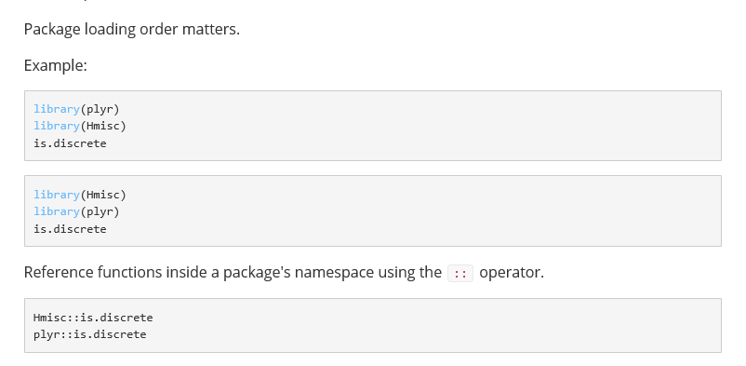
search() # for order

Slide 8
R uses scoping rules called Lexical scoping (otherwise known as static scoping).
Rules of scoping
R first searches in the environment where the function was defined.
An environment is a collection of symbols and values.
Environments have parents.

Slide 9
y <- 10
f1 <- function(x) {
y <- 2
y^2 + f2(x)
}
f2 <- function(x) {
x * y
}

Slide 10
a=1
b=2
f<-function(x)
{
a*x + b
}
g<-function(x)
{
a=2
b=1
f(x)
}
g(2)

